Slide 1

Demystifying T1-MRI to FDG¹⁸-PET Image Translation via Representational Similarity
Chia-Hsiang Kao, Yong-Sheng Chen, Li-Fen Chen, and Wei-Chen Chiu
National Yang Ming Chiao Tung University, Taiwan

Slide 2
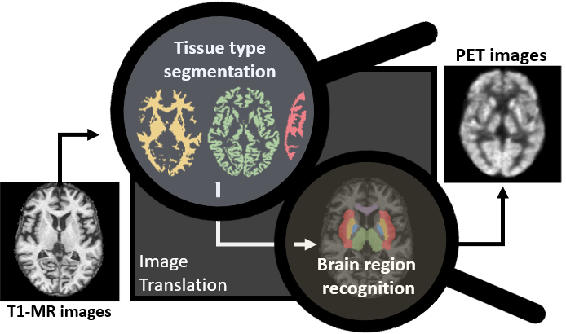
Take home message
We use representational similarity to verify our proposed hypotheses that the translation from T1-MR to PET images comprises the recognition of brain tissue types and brain regions.

Slide 3
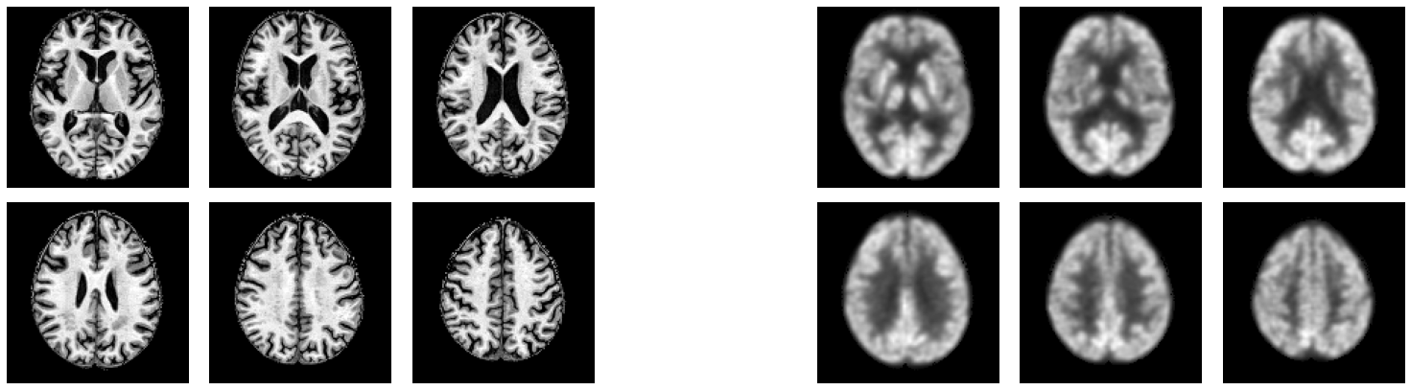
Introduction There is a growing research trend in using AI for cross-modality medical image translation.
T1-weighted Magnetic resonance imaging
(T1-MRI)
FDG¹⁸-positron emission tomography
(PET)
Principle | MRI uses strong magnetic fields to identify the anatomical structure of the brain. |  | PET measures the glucose update ability of tissue to quantify the metabolic process.
Drawback | time consuming, high cost |  | injection of radioactive tracer, high cost
DL-based image synthesis/translation
Nie, D. (2017), Pan, Y. (2018),
Sikka, A. (2018), Sun, H. (2019), Lan, H. (2020)

Slide 4
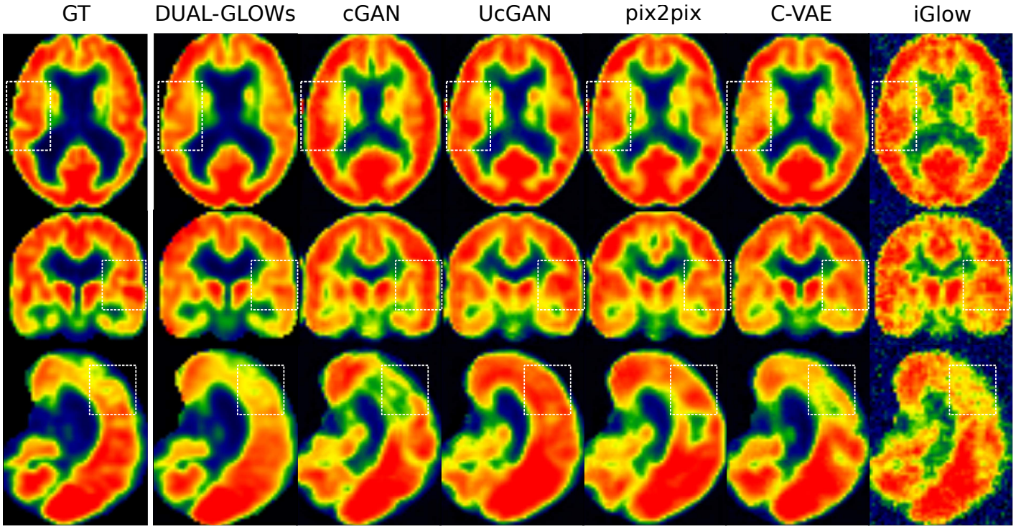
Introduction There is a growing research trend in using AI for cross-modality medical image translation.
Latest
Conventional

Slide 5
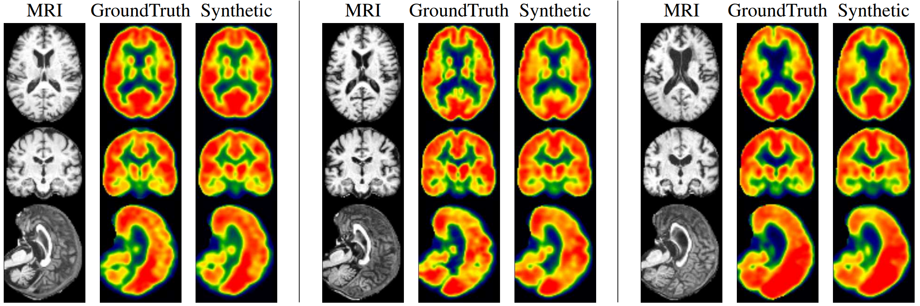
Introduction There is a growing research trend in using AI for cross-modality medical image translation.
Synthetic images are meaningful for subjects in both extremes of disease spectrum.
Left: CN. Middle: MCI. Right: AD. The generated PET images show consistency of hypometabolism (less red, more yellow) with the ground truth image.

Slide 6
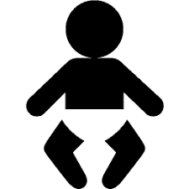

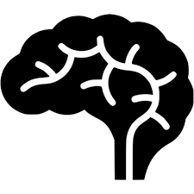




Introduction However, there are several major concerns when it comes to clinical applications.
Robustness to distributional biases (population, organs, diseases).
Robustness to systemic biases (scanning devices and protocols, preprocessing techniques).
Robustness to out-of-distribution cases, noise and adversarial perturbations.

Slide 7
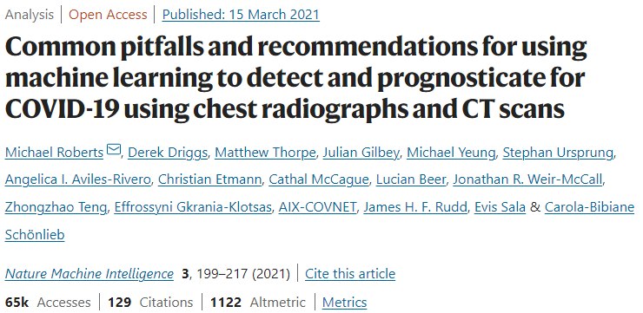
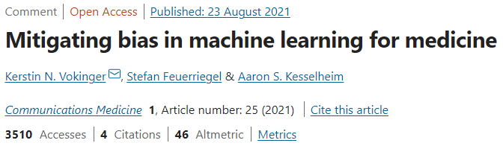
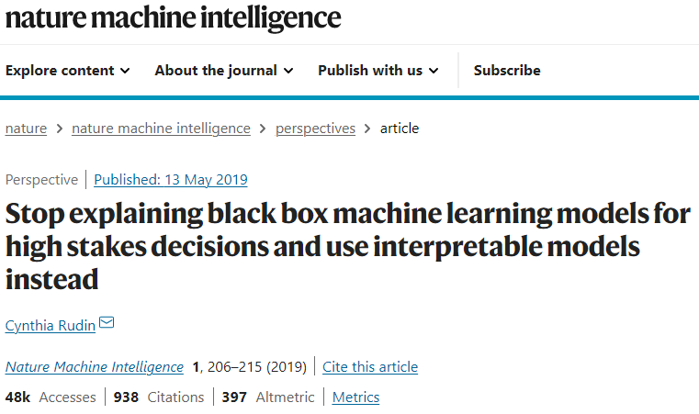
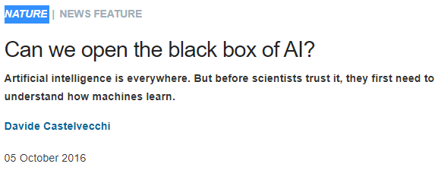
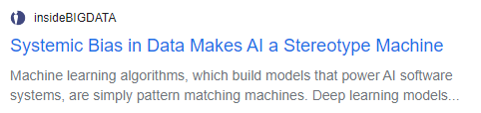
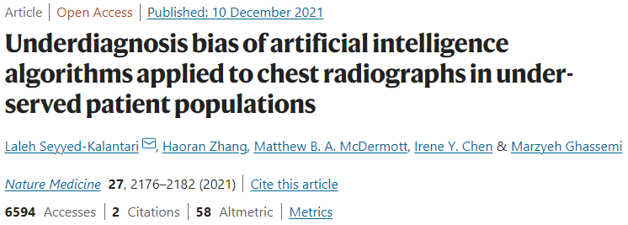
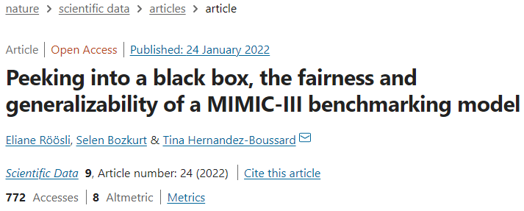
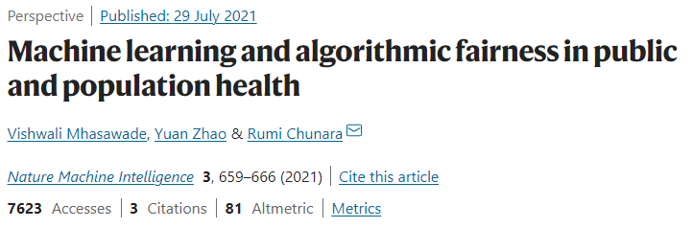
Introduction Even more, deep learning models remain black-box for most AI scientists.

Slide 8
Motivation How do deep learning models translate T1-MRI images to FDG-PET images?
?
?

Slide 9
Motivation How do deep learning models translate T1-MRI images to FDG-PET images?

Slide 10
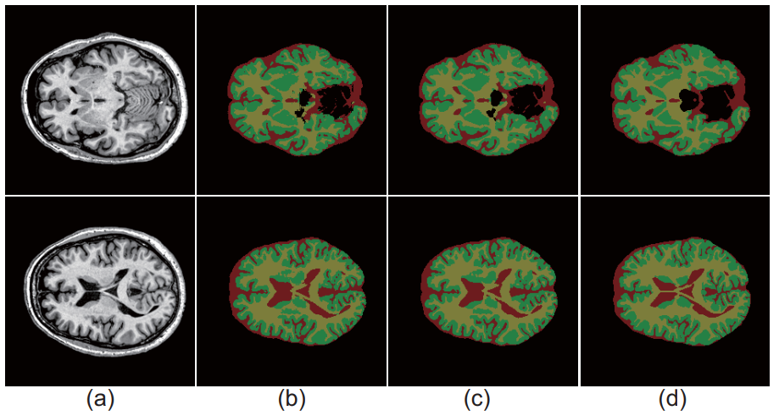
Literature Deep learning has been deployed for brain tissue segmentation and brain region identification.
The example results of validation data (yellow, green, and red colors represent the WM, GM, and CSF, respectively): (a) original MR images, (b) results of VoxResNet, (c) results of Autocontext VoxResNet, (d) ground truth label.
Chen, H., Dou, Q., Yu, L., Qin, J., & Heng, P. A. (2018). VoxResNet: Deep voxelwise residual networks for brain segmentation from 3D MR images. NeuroImage, 170, 446-455.

Slide 11
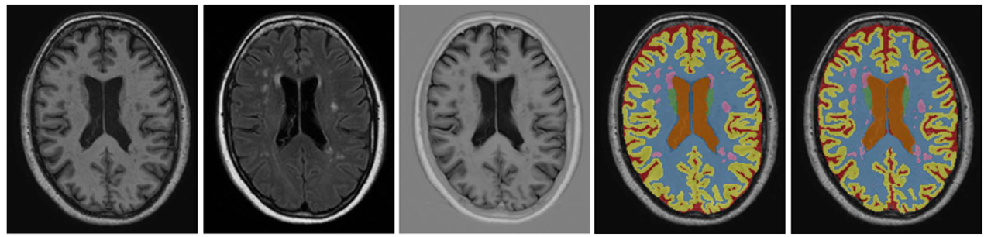
Literature Deep learning has been deployed for brain tissue segmentation and brain region identification.
Example segmentation for one of the test images from the MRBrainS13 challenge, trained using the 5 training images available within MRBrainS13.
From left to right: T1-weighted image, T2-weighted FLAIR image, T1-weighted IR image, reference segmentation and automatic segmentation.
Moeskops, P., de Bresser, J., Kuijf, H. J., Mendrik, A. M., Biessels, G. J., Pluim, J. P., & Išgum, I. (2018). Evaluation of a deep learning approach for the segmentation of brain tissues and white matter hyperintensities of presumed vascular origin in MRI. NeuroImage: Clinical, 17, 251-262.

Slide 12
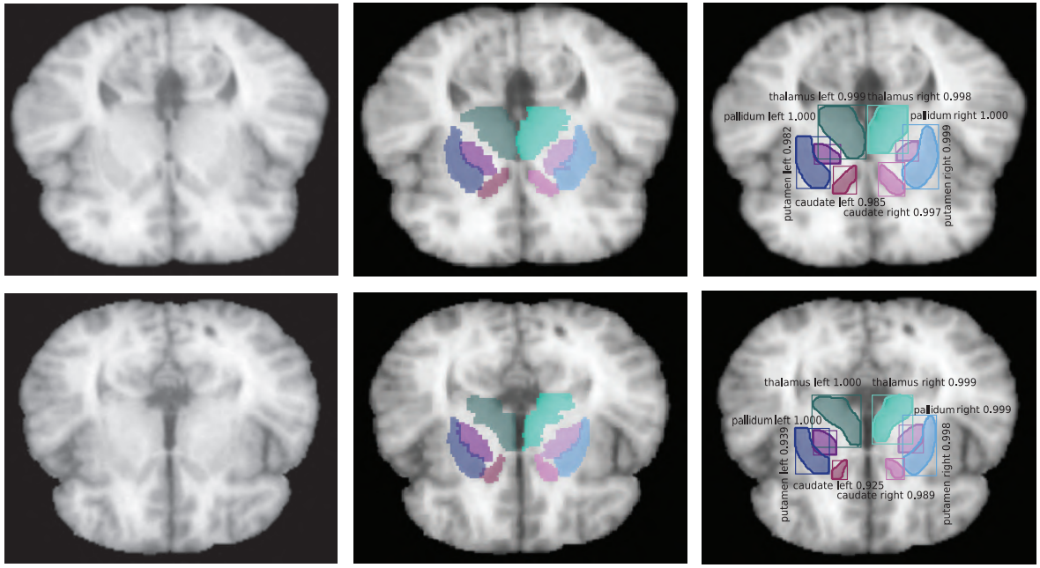
Literature Deep learning has been deployed for brain tissue segmentation and brain region identification.
Left: Randomly selected human brain MR scans are shown. Middle: Ground-truth masks of the corresponding MR scans in (a). Right: Outputs of our proposed deep learning models.
Iqbal, A., Khan, R., & Karayannis, T. (2019). Developing a brain atlas through deep learning. Nature Machine Intelligence, 1(6), 277-287.

Slide 13
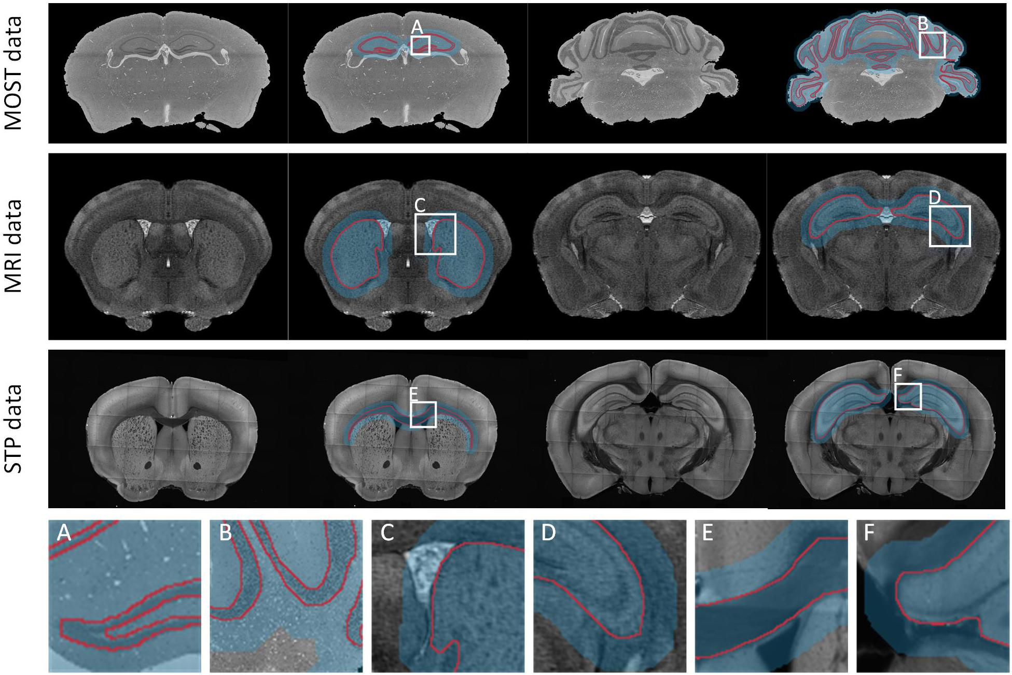
Literature Deep learning has been deployed for brain tissue segmentation and brain region identification.
Tan, C., Guan, Y., Feng, Z., Ni, H., Zhang, Z., Wang, Z., ... & Li, A. (2020). DeepBrainSeg: Automated brain region segmentation for micro-optical images with a convolutional neural network. Frontiers in neuroscience, 14, 179.

Slide 14
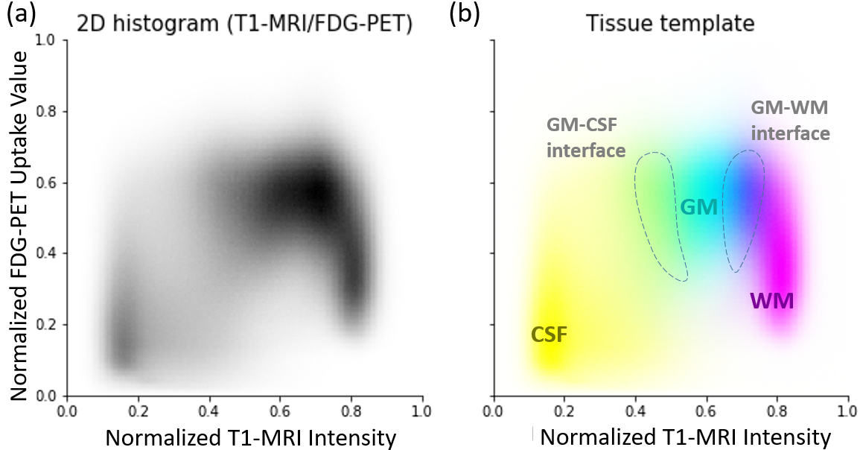
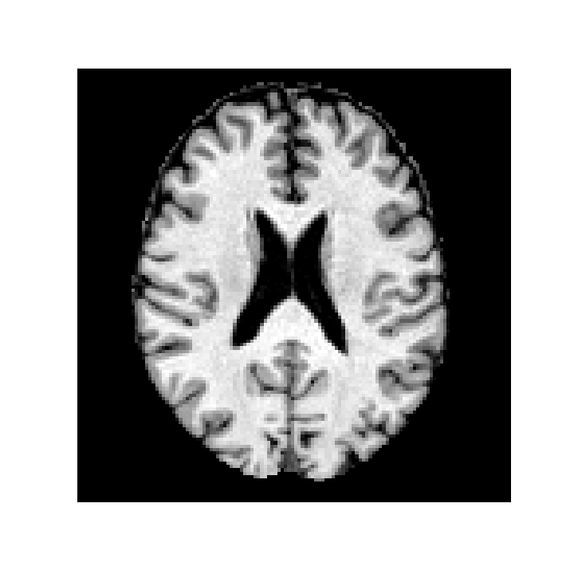
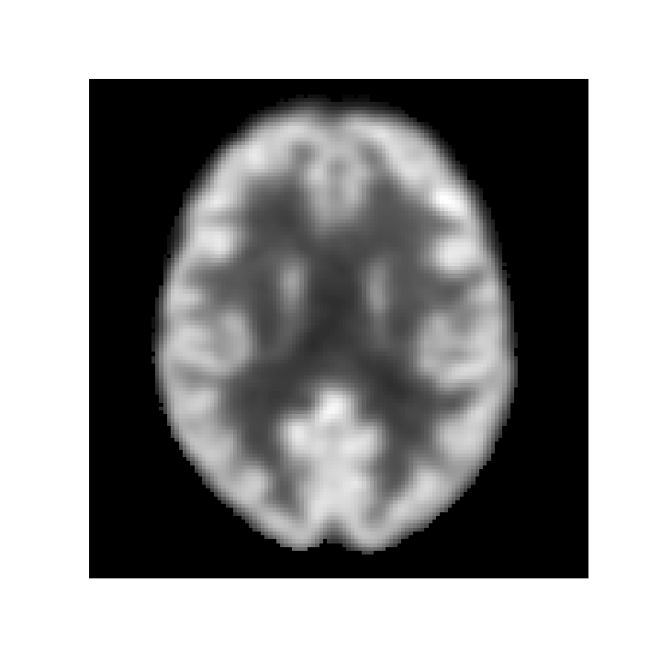
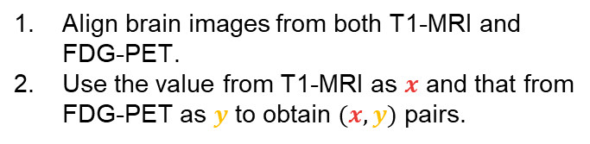
Hypothesis Deep learning models learn to segment brain tissue types.
Align brain images from both T1-MRI and FDG-PET.
Use the value from T1-MRI as $x$ and that from FDG-PET as $y$ to obtain $(x,y)$ pairs.

Slide 15
Hypothesis Deep learning models learn to segment brain tissue types.

Slide 16
Hypothesis Deep learning models learn to segment brain tissue types.
The gray matter (GM) mainly comprises the neuronal body, which consumes glucose. Thus, GM is white on FDG-PET imaging.
Partial volume effect
The white matter (WM) mainly comprises the axon, which does not consume glucose. Thus, WM is black on FDG-PET imaging.

Slide 17
Hypothesis Deep learning models learn to segment brain tissue types.
The gray matter (GM) mainly comprises the neuronal body, which consumes glucose. Thus, GM is white on FDG-PET imaging.

Slide 18
Hypothesis Deep learning models learn to segment brain tissue types.
The gray matter (GM) mainly comprises the neuronal body, which consumes glucose. Thus, GM is white on FDG-PET imaging.
The white matter (WM) mainly comprises the axon, which does not consume glucose. Thus, WM is black on FDG-PET imaging.

Slide 19
Hypothesis Deep learning models learn to segment brain tissue types.
The gray matter (GM) mainly comprises the neuronal body, which consumes glucose. Thus, GM is white on FDG-PET imaging.
Partial volume effect
The white matter (WM) mainly comprises the axon, which does not consume glucose. Thus, WM is black on FDG-PET imaging.

Slide 20
Hypothesis Deep learning models learn to segment brain tissue types.
The gray matter (GM) mainly comprises the neuronal body, which consumes glucose. Thus, GM is white on FDG-PET imaging.
Hypothesis: Deep learning models learn to segment brain tissue types.
Partial volume effect
The white matter (WM) mainly comprises the axon, which does not consume glucose. Thus, WM is black on FDG-PET imaging.

Slide 21

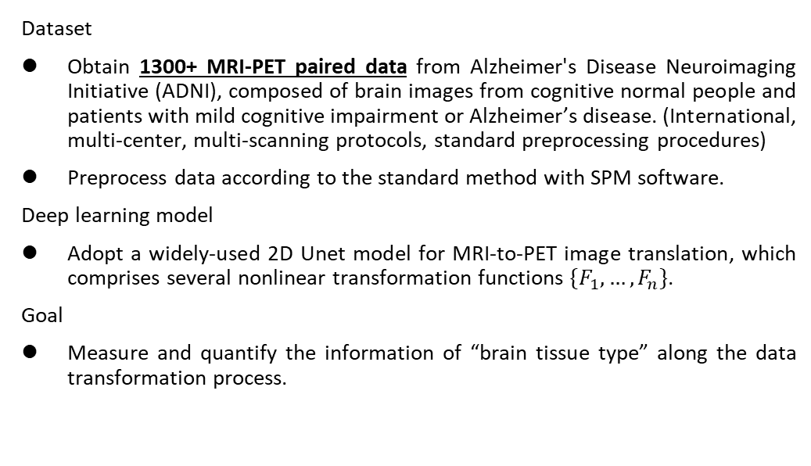
Method d
Dataset
Obtain 1300+ MRI-PET paired data from Alzheimer's Disease Neuroimaging Initiative (ADNI), composed of brain images from cognitive normal people and patients with mild cognitive impairment or Alzheimer’s disease. (International, multi-center, multi-scanning protocols, standard preprocessing procedures)
Preprocess data according to the standard method with SPM software.
Deep learning model
Adopt a widely-used 2D Unet model for MRI-to-PET image translation, which comprises several nonlinear transformation functions $\{F_{1},…,F_{n}\}$.
Goal
Measure and quantify the information of “brain tissue type” along the data transformation process.

Slide 22

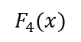
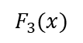
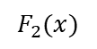
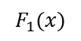
Method d
$$F_{1}(x)$$
$$F_{2}(x)$$
$$F_{3}(x)$$
$$F_{4}(x)$$
Black-box transformation process

Slide 23
Method d
$$F_{1}(x)$$
$$F_{2}(x)$$
$$F_{3}(x)$$
$$F_{4}(x)$$

Slide 24
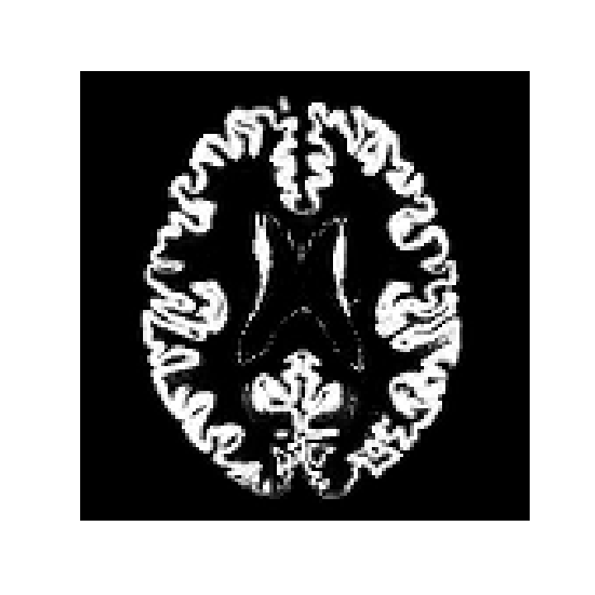
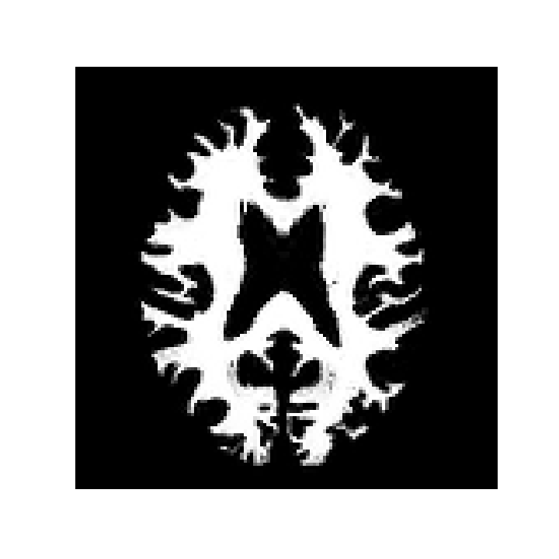
Method d
$$F_{1}(x)$$
$$F_{2}(x)$$
$$F_{3}(x)$$
$$F_{4}(x)$$
Similarity between GM and transformed data
15%
19%
65%
Similarity between WM and transformed data
85%
89%
85%

Slide 25
Method d
$$F_{1}(x)$$
$$F_{2}(x)$$
$$F_{3}(x)$$
$$F_{4}(x)$$
Similarity between GM and transformed data
15%
19%
65%
Similarity between WM and transformed data
85%
89%
85%
We can also compute the similarity between MRI (or PET) and the transformed data.

Slide 26
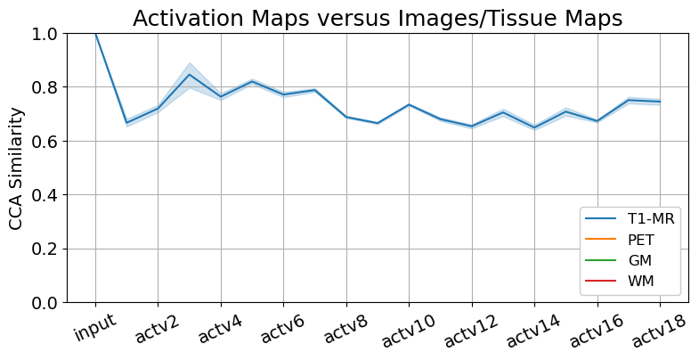
Results Brain tissues are segmented in the early encoding stage of image translation.

Slide 27
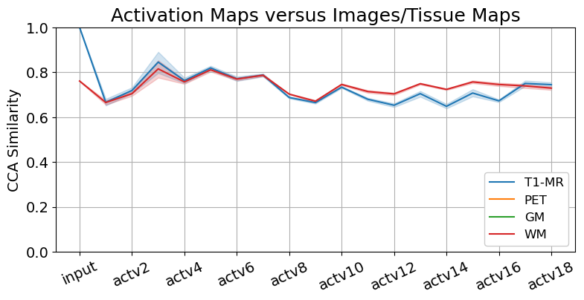
Results Brain tissues are segmented in the early encoding stage of image translation.

Slide 28
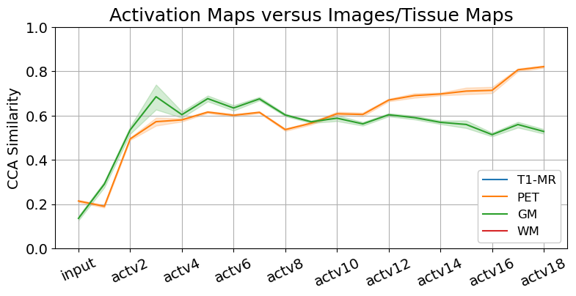
Results Brain tissues are segmented in the early encoding stage of image translation.

Slide 29
Results Brain tissues are segmented in the early encoding stage of image translation.

Slide 30
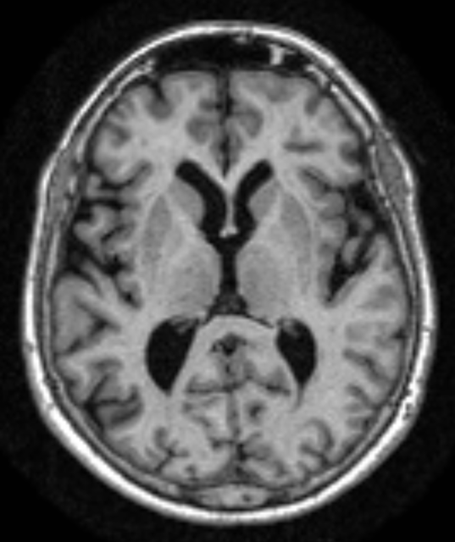
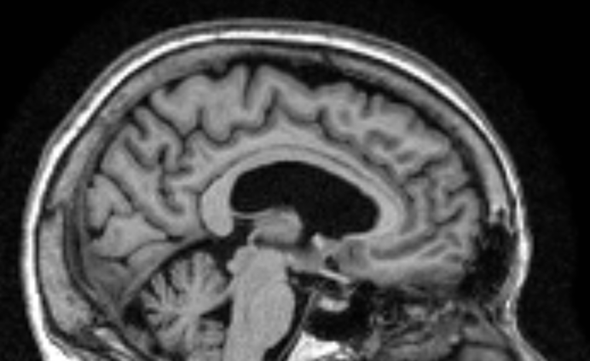
Hypothesis Deep learning models learn to segment brain regions.
Normal higher uptake regions
Least altered regions during aging
Regions of hypometabolism in AD
Brain: normal variations and benign findings in fluorodeoxyglucose-PET/computed tomography imaging. (PET Clin. 2014)
Voxel-based mapping of brain gray matter volume and glucose metabolism profiles in normal aging. (Neurobiology of Aging. 2007)
Brain PET in the diagnosis of Alzheimer's disease. (Clin Nucl Med. 2014)

Slide 31
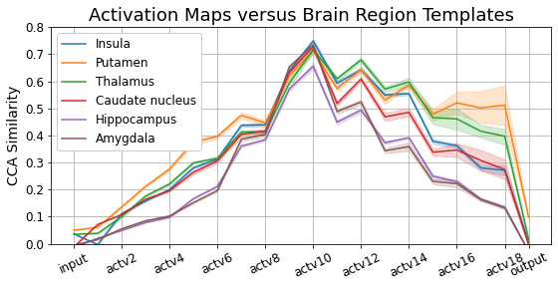
Results Brain regions are identified in the decoding stage of translation.

Slide 32
Limitation ff
Dataset – organs, diseases, modalities (e.g., different radioactive tracers), machines.
Models – various deep learning models.
Measurement of similarity – curse of dimensionality.

Slide 33
Take home message
We use representational similarity to verify our proposed hypotheses that the translation from T1-MR to PET images comprises the recognition of brain tissue types and brain regions.

